Slide 1
Budget and Planning Update
Amanda Buss
March 2019

Slide 2
Agenda
Budget Theory
Budget Development
Budget Uses
The Project
My Experience Fit
Budget & Planning Design Team
ESR - FIS Roadmap
EPBCS Timeline through January 2020
Vision for Year 1 (Pilot)
Hot Topics – Design Questions “Parking Lot”

Slide 3
Budget Theory

Slide 4
How to Develop a Budget?
Budget
Zero Based Budgeting
Traditional Budgeting
Incremental Budgeting
Activity Based Budgeting
Considers last year’s budget as the base. The changes are done based on inflation rate, consumer demand, market situation etc.
In ZBB, current year’s budget is prepared from scratch without considering the budget of the previous year
Current year’s budget is prepared by making changes in the past year’s budget considering inflation
Budget is prepared after considering the cost drivers – requires and in-depth analysis of activities incurring cost

Slide 5
How is a Budget Used?
Spending Authority (Core Funds)
Working group to determine whether this will be Budget Balance or Fund Balance in future state
Planning Activity to balance the P&L (Auxiliary, Self-supporting)
Set Targets for Revenue, Expenses, Transfers, Recharges
Accountability Tool
Monitoring deficit balances and carry-forwards

Slide 6
The Project

Slide 7
Four Pillars of the Design Lead Role
Leadership
Business Process Analysis
Training: LSS, Design Studio
Support: Lean Bench
Business Systems Analysis
Training: Oracle University
Support: Integration & Tech Leads
Support: FIS Lead, Core, Governance
Training: HDS Leadership Institute
Domain Expertise
Training: CBO, Project Work
Support: Design Team SME’s
Experience: Finance Business Partner
Experience: Template Dev -> Allocation
Experience: SalesForce Rollout
Experience
How can someone who started in September be an expert in UCSD Budget?
Heavier reliance on Design Team SME’s
Cross-training by CBO Team
Relevant projects:
TOF 2.0
Building SSP Masters model in WB
Reviewing stakeholder interview notes
Requirements documentation
Benefits:
Exposure to other budgeting practices
Understand how budgets are managed differently in private and public industry
Ability to drill into business needs

Slide 8
Budget & Planning Design Team SME’s
Name | AREA | Role/Expertise
Amanda Buss | CBO | Design Lead
Robert Hannahs | CBO | SME: Process, Reporting, Assessments
Holly-Ann Paiva Juarez | CBO | SME: SOFI, Reserve and Carry-Forwards
Adam DiProfio | VCAA | SME: Governance, Divisional Support Model
Jake Guss | VCHS | SME: Health Sciences tools, integration, & process
Kathy Smith | VCHS | SME: HSP salary planning & financial management
Anna Nordeen | ITS | SME: technical, template aggregation
Luke Hemmingson | RMP | SME: bottoms-up budget, AUX P&L, margins
Danielle Powers | FAO | SME: cross-functional, carry-forwards, recharges

Slide 9
ESR – FIS Roadmap

Slide 10
Budget & Planning Module Rough Timeline DRAFT
MONTH(S) | TASK
FEB – APR | Oracle Implementation Specialist Training and Certification Attempting to interweave training and design discussions as we go along
MAY | Design Sprints – Full Design Team Engagement
JUNE | Design Teams Run Through Business Process Testing - test cases
JULY | Configuring Reports
AUGUST | User Acceptance Testing (UAT)
SEPTEMBER | Budget Sign-off, training materials development
OCTOBER | End-User Training
NOVEMBER | Hypercare (Process for taking questions, onsite visits)
DECEMBER | Conversion
JANUARY | Pilot hybrid bottoms-up budget process (see next slide)

Slide 11
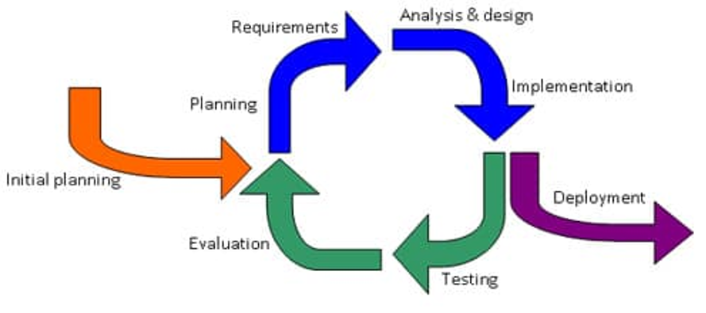
Year 1 – Soft Transition
Design Team is Here
Jan 2020 Pilot Bottoms-Up for line item budgeting:
VC-CFO (incl. HDH)
Parking & Transportation
Chancellor/Advancement
maybe one academic, research, and clinical department from AA, HS, MS.
Notes:
How will other

Slide 12
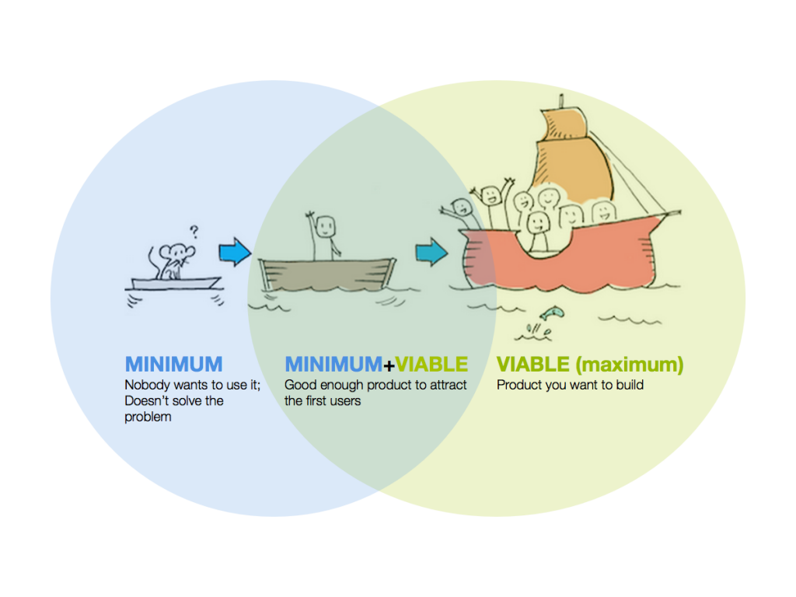
Year 1 – Soft Transition Continued
Minimum Viable Product
This means that some of the requirements will not be met until later iterations of the application deployment
Notes:
How will other

Slide 13
Hot Topics
And Design Questions “Parking Lot”

Slide 14
Design Questions in the “Parking Lot”
At this point in the project, all design leads are asked to focus on learning Oracle functionality. Design questions specific to our implementation are documented in “parking lot” collab pages.
However, I wasn’t at the Conference Room pilot demos and thus continue to research and set up working group sessions to refine future-state vision for topics that include, but are not limited to, the following:
How to roll carryforward balances from year to year?
(budget balance vs. fund balance conversations ongoing for core funds)
How do you track one-time vs. recurring budget in Oracle?
(Vanderbilt – incumbent on area to track one-time; Rutgers “no such thing as a perm budget”)
How to handle mid-year adjustments to the budget?
(re-forecast)
Position Budgeting?
(Workforce Planning submodule/business process dependencies on UCPath timeline and data)

Slide 15
Training Plan
TRAIN the TRAINER
Online Courses
Software Overlays
Key Considerations:
Number of people who will need training
Change to business process + change of system
When to use each various avenue for training
Need to teach budgeting fundamentals on top of system training

